Slide 1
Chapter 7: Normalization (Relational Database Design)

Slide 2
Outline
Features of Good Relational Design
Functional Dependencies
Decomposition Using Functional Dependencies
Normal Forms
Functional Dependency Theory
Algorithms for Decomposition using Functional Dependencies
Decomposition Using Multivalued Dependencies
More Normal Form
Atomic Domains and First Normal Form
Database-Design Process
Modeling Temporal Data

Slide 3
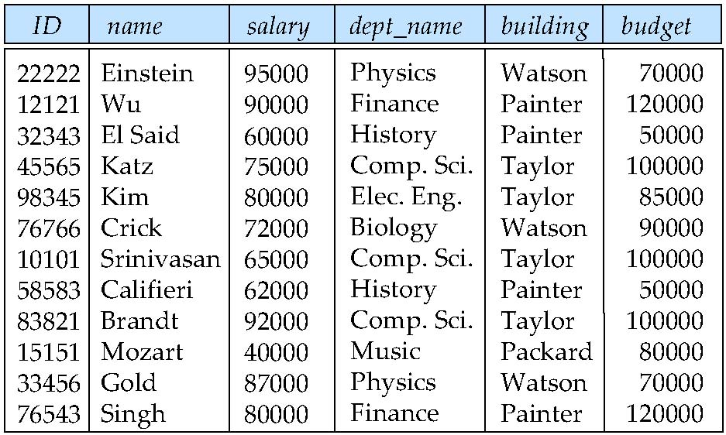
Features of Good Relational Designs
Suppose we combine instructor and department into in_dep, which represents the natural join on the relations instructor and department

Slide 4
Design Alternative: Larger Schemas
Even if we decided to live with the redundancy problem, there is still another problem with the inst dept schema. (不止只有冗余的问题)
Suppose we are creating a new department in the university. In the alternative design above, we cannot represent directly the information concerning a department (dept name, building, budget) unless that department has at least one instructor at the university. （添加新系的情况）
This is because tuples in the inst dept table require values for ID, name, and salary. （需要教工信息）

Slide 5
Decomposition
The only way to avoid the repetition-of-information problem in the in_dep schema is to decompose it into two schemas – instructor and department schemas.
Not all decompositions are good. Suppose we decompose
employee(ID, name, street, city, salary)
into
employee1 (ID, name)
employee2 (name, street, city, salary)
The problem arises when we have two employees with the same name
The next slide shows how we lose information -- we cannot reconstruct the original employee relation -- and so, this is a lossy decomposition.

Slide 6
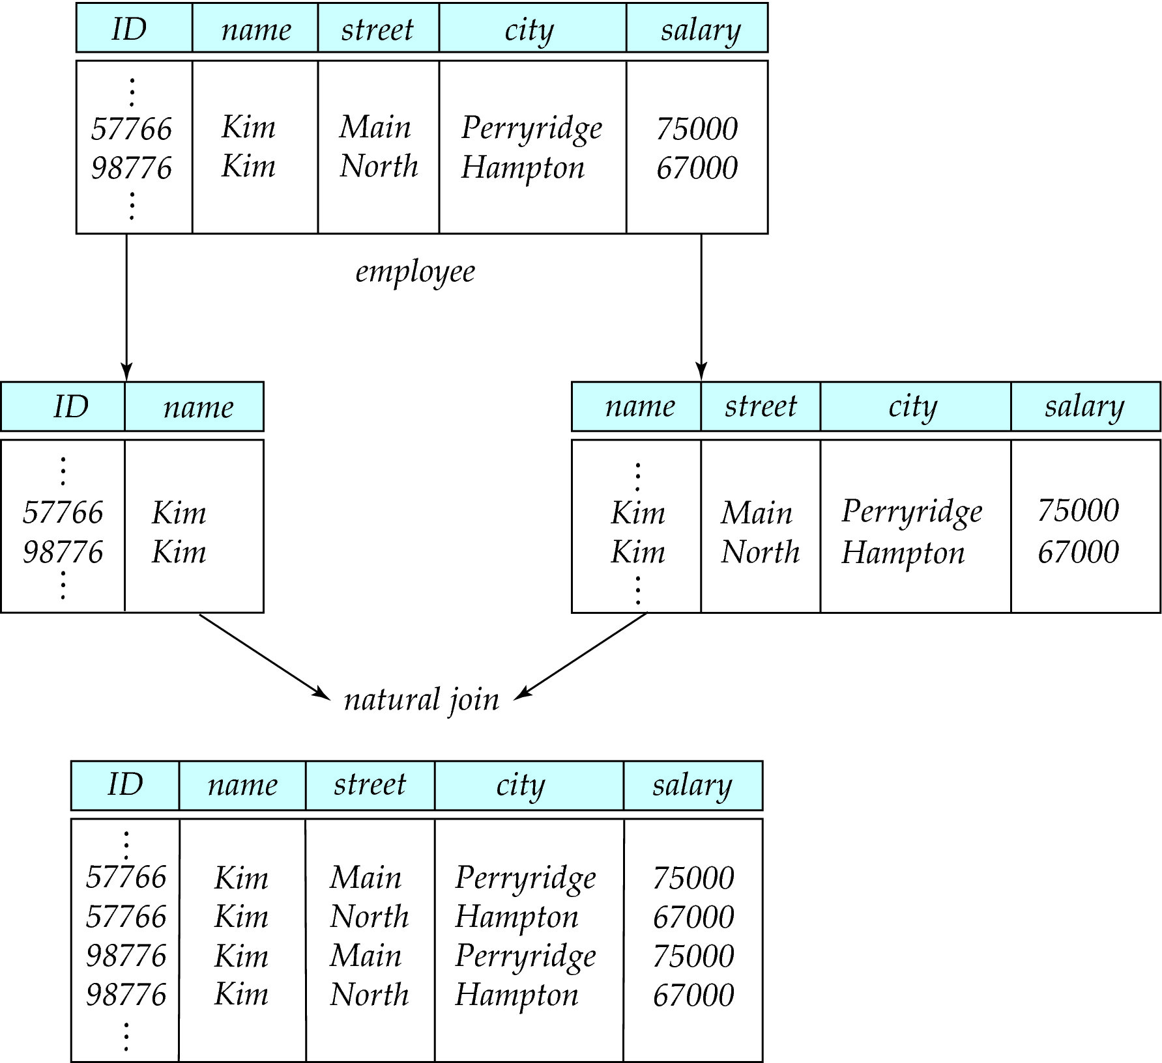
A Lossy Decomposition

Slide 7
Lossless Decomposition
Let R be a relation schema and let R₁ and R₂ form a decomposition of R . That is R = R₁ U R₂
We say that the decomposition is a lossless decomposition if there is no loss of information by replacing R with the two relation schemas R₁ U R₂
Formally,
∏ _{R1} (r) ∏ _{R2} (r) = r
And, conversely a decomposition is lossy if
r ⊂ ∏ _{R1} (r) ∏ _{R2} (r)

Slide 8
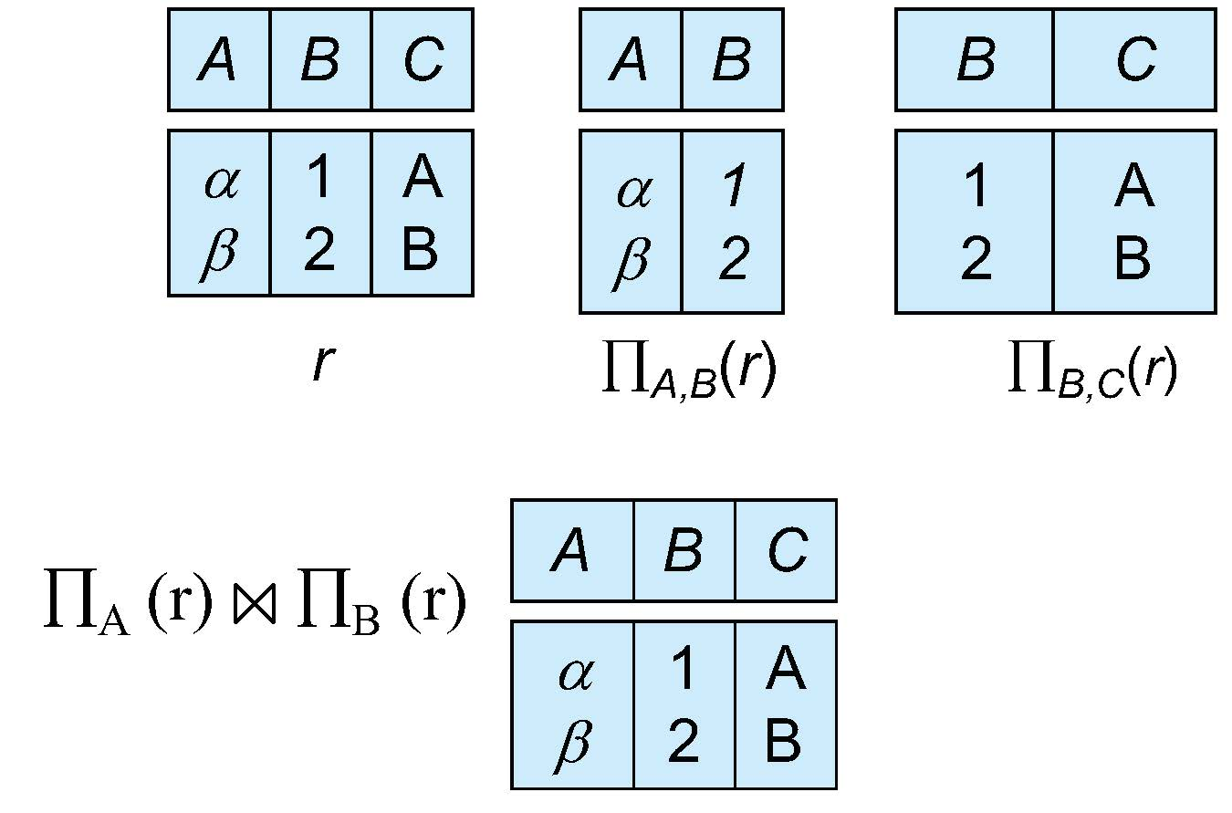
Example of Lossless Decomposition
Decomposition of R = (A, B, C) R₁ = (A, B) R₂ = (B, C)

Slide 9
Normalization Theory
Decide whether a particular relation R is in “good” form.
In the case that a relation R is not in “good” form, decompose it into set of relations {R₁, R₂, ..., R_{n}} such that
Each relation is in good form
The decomposition is a lossless decomposition
Our theory is based on:
Functional dependencies
Multivalued dependencies

Slide 10
Functional Dependencies
There are usually a variety of constraints (rules) on the data in the real world.
For example, some of the constraints that are expected to hold in a university database are:
Students and instructors are uniquely identified by their ID.
Each student and instructor has only one name.
Each instructor and student is (primarily) associated with only one department.
Each department has only one value for its budget, and only one associated building.

Slide 11
Functional Dependencies (Cont.)
An instance of a relation that satisfies all such real-world constraints is called a legal instance（合法实例） of the relation;
A legal instance of a database is one where all the relation instances are legal instances
Constraints on the set of legal relations.
Require that the value for a certain set of attributes determines uniquely the value for another set of attributes.
A functional dependency is a generalization of the notion of a key.

Slide 12
Functional Dependencies Definition
Let R be a relation schema
α ⊆ R and β ⊆ R
The functional dependency
α → β
holds on R if and only if for any legal relations r(R), whenever any two tuples t₁ and t₂ of r agree on the attributes α, they also agree on the attributes β. That is,
t₁[α] = t₂ [α] ⇒ t₁[β ] = t₂ [β ]
Example: Consider r(A,B ) with the following instance of r.
4
1 5
3 7

Slide 13
Functional Dependencies Definition
Let R be a relation schema
α ⊆ R and β ⊆ R
The functional dependency
α → β
holds on R if and only if for any legal relations r(R), whenever any two tuples t₁ and t₂ of r agree on the attributes α, they also agree on the attributes β. That is,
t₁[α] = t₂ [α] ⇒ t₁[β ] = t₂ [β ]
Example: Consider r(A,B ) with the following instance of r.
On this instance, B → A hold; A → B does NOT hold,
4
1 5
3 7

Slide 14
Closure of a Set of Functional Dependencies
Given a set F set of functional dependencies, there are certain other functional dependencies that are logically implied by F.
If A → B and B → C, then we can infer that A → C
etc.
The set of all functional dependencies logically implied by F is the closure of F.
We denote the closure of F by F⁺.

Slide 15
Keys and Functional Dependencies
K is a superkey for relation schema R if and only if K → R
K is a candidate key for R if and only if
K → R, and
for no α ⊂ K, α → R
Functional dependencies allow us to express constraints that cannot be expressed using superkeys. Consider the schema:
in_dep (ID, name, salary, dept_name, building, budget ).
We expect these functional dependencies to hold:
dept_name→ building
ID → building
but would not expect the following to hold:
dept_name → salary

Slide 16
Use of Functional Dependencies
We use functional dependencies to:
To test relations to see if they are legal under a given set of functional dependencies. （判定关系的实例是否满足给定函数依赖F）
If a relation r is legal under a set F of functional dependencies, we say that r satisfies F.
To specify constraints on the set of legal relations（说明合法关系集上的约束）
We say that F holds on R if all legal relations on R satisfy the set of functional dependencies F.
Note: A specific instance of a relation schema may satisfy a functional dependency even if the functional dependency does not hold on all legal instances.
For example, a specific instance of instructor may, by chance, satisfy name → ID.

Slide 17
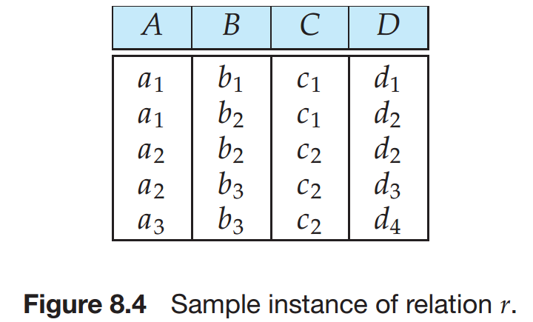
Observe that A → C is satisfied.

Slide 18
Observe that A → C is satisfied.
There are two tuples that have an A value of a1. These tuples have the same C value—namely, c1.
Similarly, the two tuples with an A value of a2 have the same C value, c2.
There are no other pairs of distinct tuples that have the same A value.

Slide 19
Observe that A → C is satisfied.
There are two tuples that have an A value of a1. These tuples have the same C value—namely, c1.
Similarly, the two tuples with an A value of a2 have the same C value, c2.
There are no other pairs of distinct tuples that have the same A value.
The functional dependency C → A is not satisfied. Why?

Slide 20
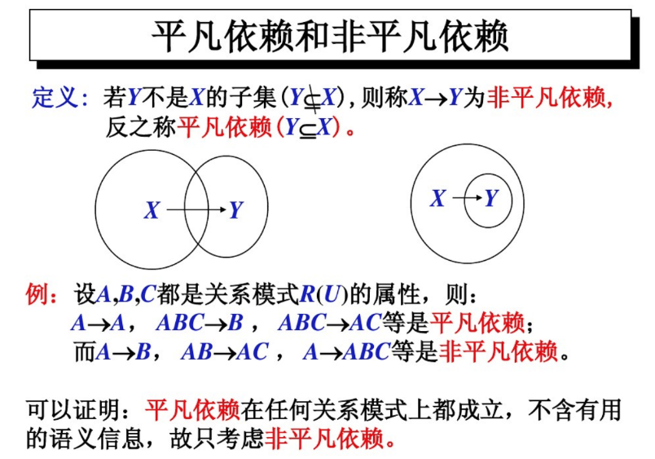
Trivial Functional Dependencies
A functional dependency is trivial（平凡） if it is satisfied by all instances of a relation
Example:
ID, name → ID
name → name
In general, α → β is trivial if β ⊆ α

Slide 21
Lossless Decomposition
We can use functional dependencies to show when certain decomposition are lossless.
For the case of R = (R₁, R₂), we require that for all possible relations r on schema R
r = ∏_{R1} (r ) ∏_{R2} (r )
A decomposition of R into R₁ and R₂ is lossless decomposition if at least one of the following dependencies is in F⁺:（ R₁ ∩ R₂ 是R₁或R₂ 的超码）
R₁ ∩ R₂ → R₁
R₁ ∩ R₂ → R₂

Slide 22
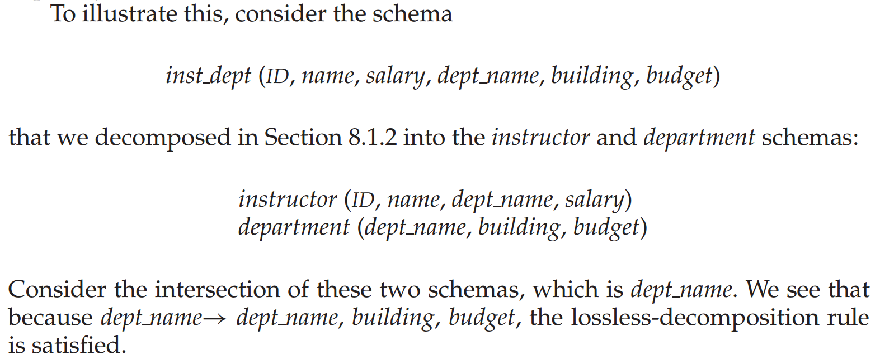
Lossless-join Decomposition（无损分解）
A decomposition of R into R₁ and R₂ is lossless join if at least one of the following dependencies is in F⁺:（ R₁ ∩ R₂ 是R₁或R₂ 的超码）
R₁ ∩ R₂ → R₁
R₁ ∩ R₂ → R₂

Slide 23
A Lossy Decomposition

Slide 24
Example
R = (A, B, C) F = {A → B, B → C)
R₁ = (A, B), R₂ = (B, C)
R₁ = (A, B), R₂ = (A, C)

Slide 25
Example
R = (A, B, C) F = {A → B, B → C)
R₁ = (A, B), R₂ = (B, C)
Lossless decomposition:
R₁ ∩ R₂ = {B} and B → BC
R₁ = (A, B), R₂ = (A, C)
Lossless decomposition:
R₁ ∩ R₂ = {A} and A → AB
Note:
B → BC
is a shorthand notation for
B → {B, C}

Slide 26
Example
R = (A, B, C) F = {A → B, B → C)
Can be decomposed in two different ways
R₁ = (A, B), R₂ = (B, C)
Lossless-join decomposition:
R₁ ∩ R₂ = {B} and B → BC
Dependency preserving （保持依赖）
R₁ = (A, B), R₂ = (A, C)
Lossless-join decomposition:
R₁ ∩ R₂ = {A} and A → AB
Not dependency preserving (cannot check B → C without computing R₁ R₂)

Slide 27
Dependency Preservation（保持依赖）
Let F_{i} be the set of dependencies F ⁺ that include only attributes in R_{i}.
A decomposition is dependency preserving, if
(F₁ ∪ F₂ ∪ … ∪ F_{n} )⁺ = F ⁺
If it is not, then checking updates for violation of functional dependencies may require computing joins, which is expensive.

Slide 28
Dependency Preservation Example
Consider a schema:
dept_advisor(s_ID, i_ID, department_name)
With function dependencies:
i_ID → dept_name
s_ID, dept_name → i_ID
In the above design we are forced to repeat the department name once for each time an instructor participates in a dept_advisor relationship.
To fix this, we need to decompose dept_advisor
Any decomposition will not include all the attributes in
s_ID, dept_name → i_ID
Thus, the composition NOT be dependency preserving

Slide 29
Boyce-Codd Normal Form
A relation schema R is in BCNF with respect to a set F of functional dependencies if for all functional dependencies in F⁺ of the form α → β where α ⊆ R and β ⊆ R, at least one of the following holds:（具有函数依赖集F的关系模式R属于BCNF的条件是：对F⁺中所有函数依赖满足：1.平凡依赖，2.左侧为超码）
α → β is trivial (i.e., β ⊆ α)
α is a superkey for R

Slide 30
Boyce-Codd Normal Form (Cont.)
Example schema that is not in BCNF:
in_dep (ID, name, salary, dept_name, building, budget )
because :
dept_name→ building, budget
holds on in_dep
but
dept_name is not a superkey
When decompose in_dept into instructor and department
instructor is in BCNF
department is in BCNF

Slide 31
Decomposing a Schema into BCNF
Let R be a schema R that is not in BCNF. Let α →β be the FD that causes a violation of BCNF.
We decompose R into:
(α U β )
( R - ( β - α ) )
In our example of in_dep,
α = dept_name
β = building, budget
and in_dep is replaced by?

Slide 32
Decomposing a Schema into BCNF
Let R be a schema R that is not in BCNF. Let α →β be the FD that causes a violation of BCNF.
We decompose R into:
(α U β )
( R - ( β - α ) )
In our example of in_dep,
α = dept_name
β = building, budget
and in_dep is replaced by
(α U β ) = ( dept_name, building, budget )
( R - ( β - α ) ) = ( ID, name, dept_name, salary )

Slide 33

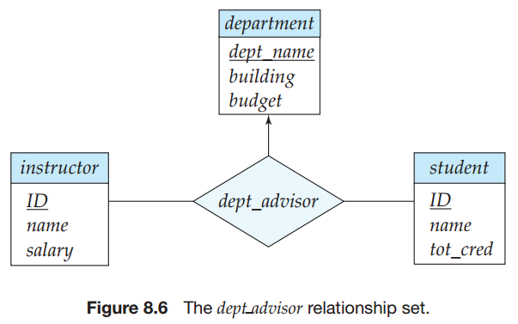


BCNF and Dependency Preservation
The E-R diagram specifies the constraint that “a student may have more than one advisor, but at most one corresponding to a given department”. （一个学生可以有多位导师，但是对应于一个给定的系最多只有一个&一个教师只能在一个系担任导师）
Dependencies
BCNF

Slide 34
Third Normal Form
A relation schema R is in third normal form (3NF) if for all:
α → β in F⁺ at least one of the following holds:
α → β is trivial (i.e., β ∈ α)
α is a superkey for R
Each attribute A in β – α is contained in a candidate key for R.
(NOTE: each attribute may be in a different candidate key-每个属性A都包含于R的一个候选码中)
If a relation is in BCNF it is in 3NF (since in BCNF one of the first two conditions above must hold).
Third condition is a minimal relaxation of BCNF to ensure dependency preservation (will see why later).（BCNF条件的最小放宽）

Slide 35
3NF Example
Consider a schema:
dept_advisor(s_ID, i_ID, dept_name)
With function dependencies:
i_ID → dept_name
s_ID, dept_name → i_ID
Two candidate keys = {s_ID, dept_name}, {s_ID, i_ID }
We have seen before that dept_advisor is not in BCNF
R, however, is in 3NF

Slide 36
3NF Example
Consider a schema:
dept_advisor(s_ID, i_ID, dept_name)
With function dependencies:
i_ID → dept_name
s_ID, dept_name → i_ID
Two candidate keys = {s_ID, dept_name}, {s_ID, i_ID }
We have seen before that dept_advisor is not in BCNF
R, however, is in 3NF
s_ID, dept_name is a superkey
i_ID → dept_name and i_ID is NOT a superkey, but:
{ dept_name} – {i_ID } = {dept_name } and
dept_name is contained in a candidate key

Slide 37
Goals of Normalization
Let R be a relation scheme with a set F of functional dependencies.
Decide whether a relation scheme R is in “good” form.
In the case that a relation scheme R is not in “good” form, need to decompose it into a set of relation scheme {R₁, R₂, ..., R_{n}} such that:
Each relation scheme is in good form
The decomposition is a lossless decomposition
Preferably, the decomposition should be dependency preserving.

Slide 38
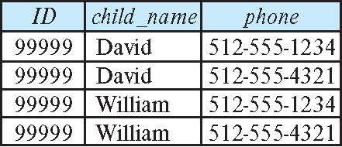
How good is BCNF?
There are database schemas in BCNF that do not seem to be sufficiently normalized
Consider a relation
inst_info (ID, child_name, phone)
where an instructor may have more than one phone and can have multiple children
Instance of inst_info

Slide 39
How good is BCNF? (Cont.)
There are no non-trivial functional dependencies and therefore the relation is in BCNF
Insertion anomalies – i.e., if we add a phone 981-992-3443 to 99999, we need to add two tuples
(99999, David, 981-992-3443) (99999, William, 981-992-3443)

Slide 40
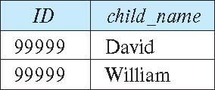
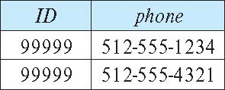
Higher Normal Forms
It is better to decompose inst_info into:
inst_child:
inst_phone:
This suggests the need for higher normal forms, such as Fourth Normal Form (4NF), which we shall see later

Slide 41
Functional-Dependency Theory

Slide 42
Functional-Dependency Theory Roadmap
We now consider the formal theory that tells us which functional dependencies are implied logically by a given set of functional dependencies.
We then develop algorithms to generate lossless decompositions into BCNF and 3NF
We then develop algorithms to test if a decomposition is dependency-preserving

Slide 43
Closure of a Set of Functional Dependencies
Given a set F set of functional dependencies, there are certain other functional dependencies that are logically implied by F.
If A → B and B → C, then we can infer that A → C
etc.
The set of all functional dependencies logically implied by F is the closure of F.
We denote the closure of F by F⁺.

Slide 44
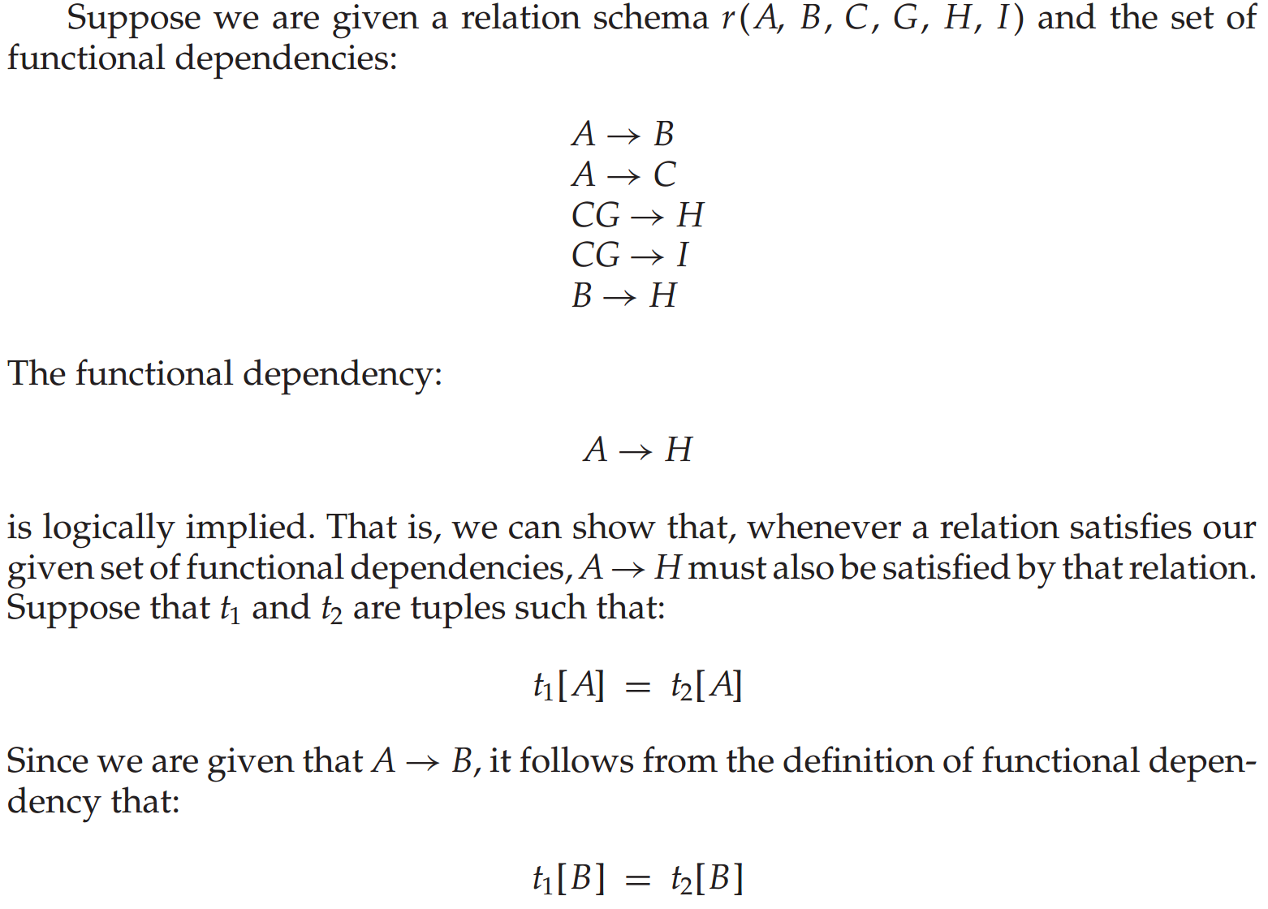
Example
关系模式
函数依赖集
被逻辑蕴含

Slide 45
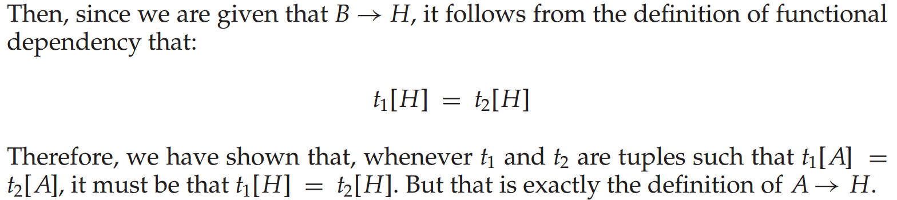
Example

Slide 46
Closure of a Set of Functional Dependencies
We can compute F⁺, the closure of F, by repeatedly applying Armstrong’s Axioms（阿姆斯特朗公里）:
Reflexive rule(自反律): if β ⊆ α, then α → β
Augmentation rule（增补率）: if α → β, then γ α → γ β
Transitivity rule（传递率）: if α → β, and β → γ, then α → γ
These rules are
Sound (有效的)-- generate only functional dependencies that actually hold, and
Complete (完备的) -- generate all functional dependencies that hold.

Slide 47
Example of F⁺
R = (A, B, C, G, H, I) F = { A → B A → C CG → H CG → I B → H}
Some members of F⁺
A → H
by transitivity from A → B and B → H
AG → I
CG → HI

Slide 48
Example of F⁺
R = (A, B, C, G, H, I) F = { A → B A → C CG → H CG → I B → H}
Some members of F⁺
A → H
by transitivity from A → B and B → H
AG → I
by augmenting A → C with G, to get AG → CG and then transitivity with CG → I （增补，传递）
CG → HI
by augmenting CG → I to infer CG → CGI,
and augmenting of CG → H to infer CGI → HI,
and then transitivity（增补，增补，传递）

Slide 49
Procedure for Computing F⁺
To compute the closure of a set of functional dependencies F:
F ⁺ = F repeat for each functional dependency f in F⁺ （ F⁺ 中的函数依赖f） apply reflexivity and augmentation rules on f add the resulting functional dependencies to F ⁺
（在f上应用自反律和增补律，将结果加入到F ⁺中） for each pair of functional dependencies f₁and f₂ in F ⁺
（F ⁺中的一对函数依赖f₁和f₂ ） if f₁ and f₂ can be combined using transitivity then add the resulting functional dependency to F ⁺
（ f₁和f₂ 可以使用传递律结合起来→将结果加入到F⁺中） until F ⁺ does not change any further（ F⁺不再发生变化）

Slide 50
Procedure for Computing F⁺
To compute the closure of a set of functional dependencies F:
F ⁺ = F repeat for each functional dependency f in F⁺ （ F⁺ 中的函数依赖f） apply reflexivity and augmentation rules on f add the resulting functional dependencies to F ⁺
（在f上应用自反律和增补律，将结果加入到F ⁺中） for each pair of functional dependencies f₁and f₂ in F ⁺
（F ⁺中的一对函数依赖f₁和f₂ ） if f₁ and f₂ can be combined using transitivity then add the resulting functional dependency to F ⁺
（ f₁和f₂ 可以使用传递律结合起来→将结果加入到F⁺中） until F ⁺ does not change any further（ F⁺不再发生变化）
NOTE: We shall see an alternative procedure for this task later
However, doing so can be expensive, since F⁺ can be large.(2^{2n})

Slide 51
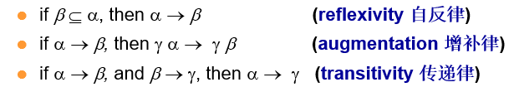
Closure of Functional Dependencies (Cont.)
Additional rules:
If α → β holds and α → γ holds, then α → β γ holds
(union合并律)
If α → β γ holds, then α → β holds and α → γ holds (decomposition 分解律)
If α → β holds and γ β → δ holds, then α γ → δ holds (pseudotransitivity 伪传递律)
The above rules can be inferred from Armstrong’s axioms.

Slide 52

Armstrong公理系统
合并律：若X → Y，X → Z，则X → YZ
X → Y
增补律
}
X → XY
}
传递律
X → YZ
X → Z
增补律
}
XY → YZ

Slide 53
Armstrong公理系统
分解律:若X → YZ ，则X → Y，X → Z
Y ⊆ YZ
Z ⊆ YZ
自反律
}
YZ → Y
YZ → Z
}
X → Y
X → Z
传递律
X → YZ

Slide 54
Armstrong公理系统
伪传递律:若X → Y，WY → Z，则WX → Z
X → Y
增补律
}
WX → WY
}
传递律
WX → Z
WY → Z

Slide 55
Closure of Attribute Sets
We say that an attribute B is functionally determined（函数确定）by α if α → B.
To test whether a set α is a superkey, we must devise an algorithm for computing the set of attributes functionally determined by α. （判定α是否为超码→被α 函数确定的属性集）
One way of doing this is to compute F⁺ , take all functional dependencies with α as the left-hand side, and take the union of the right-hand sides of all such dependencies. （通过属性闭包的包含关系，检查依赖是否属于F⁺ ）
However, doing so can be expensive, since F⁺ can be large.(2^{2n})

Slide 56
Closure of Attribute Sets
Given a set of attributes α, define the closure of α under F (denoted by α⁺) as the set of attributes that are functionally determined by α under F.(属性集α，称函数依赖集F下被α函数确定的所有属性的集合成为F下α的闭包)
Algorithm to compute α⁺, the closure of α under F
result := α; while (changes to result) do for each β → γ in F do begin if β ⊆ result then result := result ∪ γ end

Slide 57
Example of Attribute Set Closure
R = (A, B, C, G, H, I)
F = {A → B A → C CG → H CG → I B → H}
(AG)⁺

Slide 58
Example of Attribute Set Closure
R = (A, B, C, G, H, I)
F = {A → B A → C CG → H CG → I B → H}
(AG)⁺
1. result = AG
2. result = ABCG (A → C and A → B)
3. result = ABCGH (CG → H and CG ⊆ AGBC)
4. result = ABCGHI (CG → I and CG ⊆ AGBCH)
Is AG a candidate key?
Is AG a super key?
Does AG → R? == Is (AG)⁺ ⊇ R
Is any subset of AG a superkey?
Does A → R? == Is (A)⁺ ⊇ R
Does G → R? == Is (G)⁺ ⊇ R
In general: check for each subset of size n-1

Slide 59
Uses of Attribute Closure
There are several uses of the attribute closure algorithm:(用途)
Testing for superkey:（判断超码）
To test if α is a superkey, we compute α^{+,} and check if α⁺ contains all attributes of R.
Testing functional dependencies（判断函数依赖：通过检测β ⊆ α⁺，可以检查函数依赖α → β 是否成立→简单、低代价、高可用）
To check if a functional dependency α → β holds (or, in other words, is in F⁺), just check if β ⊆ α⁺.
That is, we compute α⁺ by using attribute closure, and then check if it contains β.
Is a simple and cheap test, and very useful
Computing closure of F（计算函数依赖闭包）
For each γ ⊆ R, we find the closure γ⁺, and for each S ⊆ γ⁺, we output a functional dependency γ → S.

Slide 60
Canonical Cover（正则覆盖）
Sets of functional dependencies may have redundant dependencies that can be inferred from the others（函数依赖集中可能存在冗余的依赖）
For example: A → C is redundant in: {A → B, B → C, A→ C}
Parts of a functional dependency may be redundant
E.g.: on RHS: {A → B, B → C, A → CD} can be simplified to {A → B, B → C, A → D}
E.g.: on LHS: {A → B, B → C, AC → D} can be simplified to {A → B, B → C, A → D}
Intuitively, a canonical cover of F is a “minimal” set of functional dependencies equivalent to F, having no redundant dependencies or redundant parts of dependencies. （正则覆盖是最小的、不含无关属性、与F具有相同闭包的依赖集）

Slide 61
Extraneous Attributes（无关属性）
Removing an attribute from the left side of a functional dependency could make it a stronger constraint（从左侧移除->更强的约束）.
For example, if we have AB → C and remove B, we get the possibly stronger result A → C. It may be stronger because A → C logically implies AB → C, but AB → C does not, on its own, logically imply A → C
But, depending on what our set F of functional dependencies happens to be, we may be able to remove B from AB → C safely.
For example, suppose that
F = {AB → C, A → D, D → C}
Then we can show that F logically implies A → C, making extraneous in AB → C.

Slide 62
Extraneous Attributes (Cont.)
Removing an attribute from the right side of a functional dependency could make it a weaker constraint（从右侧移除->更弱的约束）.
For example, if we have AB → CD and remove C, we get the possibly weaker result AB → D. It may be weaker because using just AB → D, we can no longer infer AB → C.
But, depending on what our set F of functional dependencies happens to be, we may be able to remove C from AB → CD safely.
For example, suppose that
F = { AB → CD, A → C}.
Then we can show that even after replacing AB → CD by AB → D, we can still infer AB → C and thus AB → CD.

Slide 63
Extraneous Attributes（无关属性）
Consider a set F of functional dependencies and the functional dependency α → β in F.
Attribute A is extraneous in α if A ∈ α and F logically implies (F – {α → β}) ∪ { (α – A) → β } .
Attribute A is extraneous in β if A ∈ β and the set of functional dependencies (F – {α → β} ) ∪ { α →(β – A) } logically implies F.
Note: implication in the opposite direction is trivial in each of the cases above, since a “stronger” functional dependency always implies a weaker one（删除无关属性不影响表达力）
Example: Given F = {A → C, AB → C }
Example: Given F = {A → C, AB → CD}

Slide 64
Extraneous Attributes（无关属性）
Consider a set F of functional dependencies and the functional dependency α → β in F.
Attribute A is extraneous in α if A ∈ α and F logically implies (F – {α → β}) ∪ { (α – A) → β } .
Attribute A is extraneous in β if A ∈ β and the set of functional dependencies (F – {α → β} ) ∪ { α →(β – A) } logically implies F.
Note: implication in the opposite direction is trivial in each of the cases above, since a “stronger” functional dependency always implies a weaker one（删除无关属性不影响表达力）
Example: Given F = {A → C, AB → C }
B is extraneous in AB → C because {A → C, AB → C} logically implies A → C (I.e. the result of dropping B from AB → C).
Example: Given F = {A → C, AB → CD}
C is extraneous in AB → CD since AB → C can be inferred even after deleting C

Slide 65
Testing if an Attribute is Extraneous
Consider a set F of functional dependencies and the functional dependency α → β in F.
To test if attribute A ∈ α is extraneous in α
compute ({α} – A)⁺ using the dependencies in F
check that ({α} – A)⁺ contains β; if it does, A is extraneous in α
（计算去除属性A的闭包，若右侧属性被包含，A即为无关属性）
To test if attribute A ∈ β is extraneous in β
compute α⁺ using only the dependencies in F’ = (F – {α → β}) ∪ {α →(β – A)},
check that α⁺ contains A; if it does, A is extraneous in β
（在去除属性A依赖后的依赖集上，计算α的闭包，若属性A被包含，A即为无关属性）

Slide 66
Examples of Extraneous Attributes
Let F = {AB → CD, A → E, E → C }
To check if C is extraneous in AB → CD, we:

Slide 67
Examples of Extraneous Attributes
Let F = {AB → CD, A → E, E → C }
To check if C is extraneous in AB → CD, we:
Compute the attribute closure of AB under F' = {AB → D, A → E, E → C}
The closure is ABCDE, which includes CD
This implies that C is extraneous

Slide 68
Canonical Cover（正则覆盖）
A canonical cover for F is a set of dependencies F_{c} such that
F logically implies（逻辑蕴含） all dependencies in F_{c,} and F_{c} logically implies all dependencies in F, and（相同的闭包）
No functional dependency in F_{c} contains an extraneous attribute, and
Each left side of functional dependency in F_{c} is unique.（没有无关属性且函数依赖左半部分是唯一的）
To compute a canonical cover for F: repeat Use the union rule to replace any dependencies in F（利用合并律） α₁ → β₁ and α₁ → β₂ with α₁ → β₁ β₂ Find a functional dependency α → β with an （对每个函数依赖） extraneous attribute either in α or in β （找无关属性） /* Note: test for extraneous attributes done using F_{c,} not F*/ If an extraneous attribute is found, delete it from α → β（删无关属性） until F does not change
Note: Union rule may become applicable after some extraneous attributes have been deleted, so it has to be re-applied

Slide 69
Computing a Canonical Cover
R = (A, B, C) F = {A → BC B → C A → B AB → C}

Slide 70
Computing a Canonical Cover
R = (A, B, C) F = {A → BC B → C A → B AB → C}
Combine A → BC and A → B into A → BC
Set is now {A → BC, B → C, AB → C}
A is extraneous in AB → C
Check if the result of deleting A from AB → C is implied by the other dependencies
Yes: in fact, B → C is already present!
Set is now {A → BC, B → C}
C is extraneous in A → BC
Check if A → C is logically implied by A → B and the other dependencies
Yes: using transitivity on A → B and B → C.
Can use attribute closure of A in more complex cases
The canonical cover is: A → B B → C

Slide 71
Dependency Preservation
Let F_{i} be the set of dependencies F ⁺ that include only attributes in R_{i}.
A decomposition is dependency preserving, if
(F₁ ∪ F₂ ∪ … ∪ F_{n} )⁺ = F ⁺
Using the above definition, testing for dependency preservation take exponential time.
Not that if a decomposition is NOT dependency preserving then checking updates for violation of functional dependencies may require computing joins, which is expensive.

Slide 72
Dependency Preservation (Cont.)
Let F be the set of dependencies on schema R and let R₁, R₂ , .., R_{n} be a decomposition of R.
The restriction of F to R_{i} is the set F_{i} of all functional dependencies in F ⁺ that include only attributes of R_{i} .
Since all functional dependencies in a restriction involve attributes of only one relation schema, it is possible to test such a dependency for satisfaction by checking only one relation.
Note that the definition of restriction uses all dependencies in in F ⁺, not just those in F.

Slide 73
Testing for Dependency Preservation
To check if a dependency α → β is preserved in a decomposition of R into R₁, R₂, …, R_{n} ， we apply the following test (with attribute closure done with respect to F)（测试α → β 依赖是否依然保持）
result = α while (changes to result) do for each R_{i} in the decomposition（依赖在各个分解中是否体现） t = (result ∩ R_{i})⁺ ∩ R_{i} result = result ∪ t
If result contains all attributes in β, then the functional dependency α → β is preserved.
We apply the test on all dependencies in F to check if a decomposition is dependency preserving
This procedure takes polynomial time（多项式时间）, instead of the exponential time（指数时间） required to compute F⁺ and (F₁ ∪ F₂ ∪ … ∪ F_{n})⁺

Slide 74
Example
R = (A, B, C ) F = {A → B B → C} Key = {A}

Slide 75
Example
R = (A, B, C ) F = {A → B B → C} Key = {A}
R is not in BCNF
Decomposition R₁ = (A, B), R₂ = (B, C)

Slide 76
Example
R = (A, B, C ) F = {A → B B → C} Key = {A}
R is not in BCNF
Decomposition R₁ = (A, B), R₂ = (B, C)
R₁ and R₂ in BCNF
Lossless-join decomposition
Dependency preserving

Slide 77
Testing for BCNF
To check if a non-trivial dependency α →β causes a violation of BCNF
1. compute α⁺ (the attribute closure of α), and
verify that it includes all attributes of R, that is, it is a superkey of R.
（每个非平凡依赖由超码决定）
Simplified test: To check if a relation schema R is in BCNF, it suffices to check only the dependencies in the given set F for violation of BCNF, rather than checking all dependencies in F⁺. （只需检查给定集合F中的函数依赖是否违法BCNF就足够了）
If none of the dependencies in F causes a violation of BCNF, then none of the dependencies in F⁺ will cause a violation of BCNF either.
However, simplified test using only F is incorrect when testing a relation in a decomposition of R（分解之后上一步检测即不再适用）
Consider R = (A, B, C, D, E), with F = { A → B, BC → D}
Decompose R into R₁ = (A,B) and R₂ = (A,C,D, E)

Slide 78
Testing for BCNF
To check if a non-trivial dependency α →β causes a violation of BCNF
1. compute α⁺ (the attribute closure of α), and
2. verify that it includes all attributes of R, that is, it is a superkey of R.
Simplified test: To check if a relation schema R is in BCNF, it suffices to check only the dependencies in the given set F for violation of BCNF, rather than checking all dependencies in F⁺.
If none of the dependencies in F causes a violation of BCNF, then none of the dependencies in F⁺ will cause a violation of BCNF either.
However, simplified test using only F is incorrect when testing a relation in a decomposition of R（分解之后上一步检测即不再适用）
Consider R = (A, B, C, D, E), with F = { A → B, BC → D}
Decompose R into R₁ = (A,B) and R₂ = (A,C,D, E)
Neither of the dependencies in F contain only attributes from (A,C,D,E) so we might be mislead into thinking R₂ satisfies BCNF. （F中没有依赖包含R₂的属性）
In fact, dependency AC → D in F⁺ shows R₂ is not in BCNF.

Slide 79
Testing Decomposition for BCNF
To check if a relation R_{i} in a decomposition of R is in BCNF
Either test R_{i} for BCNF with respect to the restriction of F⁺ to R_{i} (that is, all FDs in F⁺ that contain only attributes from R_{i})
Or use the original set of dependencies F that hold on R, but with the following test:
for every set of attributes α ⊆ R_{i}, check that α⁺ (F下 α的闭包) either includes no attribute of R_{i}- α, or includes all attributes of R_{i}. （对于R_{i}中属性的每个子集α ，确保α⁺ （F下α的属性闭包）要么不包含R_{i}- α的任何属性，要么包含R_{i}的所有属性）
If the condition is violated by some α → β in F⁺, the dependency α → (α⁺ - α) ∩ R_{i} can be shown to hold on R_{i}, and R_{i} violates BCNF.

Slide 80
BCNF Decomposition Algorithm
result := {R }; done := false; compute F ⁺; while (not done) do if (there is a schema R_{i} in result that is not in BCNF) then begin let α → β be a nontrivial functional dependency that holds on R_{i} such that α → R_{i} is not in F ⁺, and α ∩ β = ∅; result := (result – R_{i} ) ∪ (R_{i} – β) ∪ (α, β ); end else done := true;
Note: each R_{i} is in BCNF, and decomposition is lossless-join（算法结果不仅是一个BCNF分解，而且是一个无损分解：(R_{i} – β) ∩(α, β )=α ）
.

Slide 81
BCNF and Dependency Preservation
It is not always possible to get a BCNF decomposition that is
dependency preserving（无法同时保持函数依赖）
R = (J, K, L ) F = {JK → L L → K } Two candidate keys = JK and JL
R is not in BCNF
Any decomposition of R will fail to preserve
JK → L ( 损失了该依赖关系 )
This implies that testing for JK → L requires a join

Slide 82
Example of BCNF Decomposition
R = (A, B, C ) F = {A → B B → C} Key = {A}
R is not in BCNF (B → C but B is not superkey)
Decomposition
R₁ = (B, C)
R₂ = (A,B)

Slide 83
Example of BCNF Decomposition
class (course_id, title, dept_name, credits, sec_id, semester, year, building, room_number, capacity, time_slot_id)
Functional dependencies:
course_id→ title, dept_name, credits
building, room_number→capacity
course_id, sec_id, semester, year→building, room_number, time_slot_id
A candidate key {course_id, sec_id, semester, year}.
BCNF Decomposition:
course_id→ title, dept_name, credits holds
but course_id is not a superkey.
We replace class by:

Slide 84
Example of BCNF Decomposition
class (course_id, title, dept_name, credits, sec_id, semester, year, building, room_number, capacity, time_slot_id)
Functional dependencies:
course_id→ title, dept_name, credits
building, room_number→capacity
course_id, sec_id, semester, year→building, room_number, time_slot_id
A candidate key {course_id, sec_id, semester, year}.
BCNF Decomposition:
course_id→ title, dept_name, credits holds
but course_id is not a superkey.
We replace class by:
course(course_id, title, dept_name, credits)
class-1 (course_id, sec_id, semester, year, building, room_number, capacity, time_slot_id)

Slide 85
BCNF Decomposition (Cont.)
course is in BCNF
How do we know this?
building, room_number→capacity holds on class-1
but {building, room_number} is not a superkey for class-1.
We replace class-1 by:
classroom (building, room_number, capacity)
section (course_id, sec_id, semester, year, building, room_number, time_slot_id)
classroom and section are in BCNF.

Slide 86
Third Normal Form
There are some situations where
BCNF is not dependency preserving（并不能保持依赖）, and
efficient checking for FD violation on updates is important
Solution: define a weaker normal form, called Third Normal Form (3NF)
Allows some redundancy (with resultant problems冗余问题; we will see examples later)
But functional dependencies can be checked on individual relations without computing a join.
There is always a lossless-join, dependency-preserving decomposition into 3NF.

Slide 87
3NF Example -- Relation dept_advisor
dept_advisor (s_ID, i_ID, dept_name) F = {s_ID, dept_name → i_ID, i_ID → dept_name}
Two candidate keys: s_ID, dept_name, and i_ID, s_ID
R is in 3NF
s_ID, dept_name → i_ID
s_ID dept_name is a superkey
i_ID → dept_name
dept_name is contained in a candidate key

Slide 88
Redundancy in 3NF
There is some redundancy in this schema（冗余）
Example of problems due to redundancy in 3NF
R = (J, K, L) F = {JK → L, L → K }
J
L
K
j₁
j₂
j₃
null
l₁
l₁
l₁
l₂
k₁
k₁
k₁
k₂
dept_advisor (s_ID, i_ID, dept_name) F = {s_ID, dept_name → i_ID, i_ID → dept_name}
repetition of information (e.g., the relationship l₁, k₁)
(i_ID, dept_name)
need to use null values (e.g., to represent the relationship l₂, k₂ where there is no corresponding value for J).
(i_ID, dept_nameI) if there is no separate relation mapping instructors to departments

Slide 89
Testing for 3NF
Need to check only FDs in F, need not check all FDs in F⁺.
Use attribute closure to check for each dependency α → β, if α is a superkey.
If α is not a superkey, we have to verify if each attribute in β is contained in a candidate key of R
This test is rather more expensive, since it involve finding candidate keys
Interestingly, decomposition into third normal form (described shortly) can be done in polynomial time

Slide 90
3NF Decomposition Algorithm
Let F_{c} be a canonical cover for F; i := 0; for each functional dependency α → β in F_{c} do if none of the schemas R_{j}, 1 ≤ j ≤ i contains α β then begin i := i + 1; R_{i} := α β end if none of the schemas R_{j}, 1 ≤ j ≤ i contains a candidate key for R then begin i := i + 1; R_{i} := any candidate key for R; end /* Optionally, remove redundant relations */（）
repeat if any schema R_{j} is contained in another schema R_{k} then /* delete R_{j} */ R_{j} = R;; i=i-1; return (R₁, R₂, ..., R_{i})

Slide 91
3NF Decomposition Algorithm (Cont.)
Above algorithm ensures
Each relation schema R_{i} is in 3NF
Decomposition is dependency preserving and lossless-join

Slide 92
3NF Decomposition: An Example
Relation schema:
cust_banker_branch = (customer_id, employee_id, branch_name, type )
The functional dependencies for this relation schema are:
customer_id, employee_id → branch_name, type
employee_id → branch_name
customer_id, branch_name → employee_id
We first compute a canonical cover

Slide 93
3NF Decomposition: An Example
Relation schema:
cust_banker_branch = (customer_id, employee_id, branch_name, type )
The functional dependencies for this relation schema are:
customer_id, employee_id → branch_name, type
employee_id → branch_name
customer_id, branch_name → employee_id
We first compute a canonical cover
branch_name is extraneous in the r.h.s. of the 1st dependency
No other attribute is extraneous, so we get F_{C} =
customer_id, employee_id → type employee_id → branch_name customer_id, branch_name → employee_id

Slide 94
3NF Decompsition Example (Cont.)
The for loop generates following 3NF schema:
(customer_id, employee_id, type )
(employee_id, branch_name)
(customer_id, branch_name, employee_id)
Observe that (customer_id, employee_id, type ) contains a candidate key of the original schema, so no further relation schema needs be added
At end of for loop, detect and delete schemas, such as (employee_id, branch_name), which are subsets of other schemas
result will not depend on the order in which FDs are considered
The resultant simplified 3NF schema is:
(customer_id, employee_id, type)
(customer_id, branch_name, employee_id)

Slide 95
Comparison of BCNF and 3NF
It is always possible to decompose a relation into a set of relations that are in 3NF such that:
The decomposition is lossless
The dependencies are preserved
It is always possible to decompose a relation into a set of relations that are in BCNF such that:
The decomposition is lossless
It may not be possible to preserve dependencies.

Slide 96
Design Goals
Goal for a relational database design is:
BCNF.
Lossless join.
Dependency preservation.
If we cannot achieve this, we accept one of
Lack of dependency preservation
Redundancy due to use of 3NF

Slide 97
Multivalued Dependencies

Slide 98
Multivalued Dependencies (MVDs)多值依赖
Suppose we record names of children, and phone numbers for instructors:
inst_child(ID, child_name)
inst_phone(ID, phone_number)
If we were to combine these schemas to get
inst_info(ID, child_name, phone_number)
Example data: (99999, David, 512-555-1234) (99999, David, 512-555-4321) (99999, William, 512-555-1234) (99999, William, 512-555-4321)
This relation is in BCNF
Why?

Slide 99
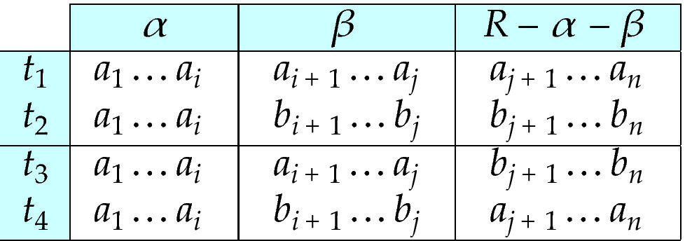
Multivalued Dependencies
Let R be a relation schema and let α ⊆ R and β ⊆ R. The multivalued dependency （多值依赖）
α →→ β
holds on R if in any legal relation r(R), for all pairs for tuples t₁ and t₂ in r such that t₁[α] = t₂ [α], there exist tuples t₃ and t₄ in r such that:
t₁[α] = t₂ [α] = t₃ [α] = t₄ [α] t₃[β] = t₁ [β] t₃[R – β] = t₂[R – β] t₄ [β] = t₂[β] t₄[R – β] = t₁[R – β]
Tabular representation of α →→ β

Slide 100
MVD (Cont.)
Let R be a relation schema with a set of attributes that are partitioned into 3 nonempty subsets（非空子集）.
Y, Z, W
We say that Y →→ Z (Y multidetermines Z ) if and only if for all possible relations r (R )
< y₁, z₁, w₁ > ∈ r and < y₁, z₂, w₂ > ∈ r
then
< y₁, z₁, w₂ > ∈ r and < y₁, z₂, w₁ > ∈ r
Note that since the behavior of Z and W are identical it follows that
Y →→ Z if Y →→ W

Slide 101
Example
In our example:
ID →→ child_name ID →→ phone_number
The above formal definition is supposed to formalize the notion that given a particular value of Y (ID) it has associated with it a set of values of Z (child_name) and a set of values of W (phone_number), and these two sets are in some sense independent of each other.
Note:
If Y → Z then Y →→ Z
Indeed we have (in above notation) Z₁ = Z₂ The claim follows.

Slide 102
Use of Multivalued Dependencies
We use multivalued dependencies in two ways:
1. To test relations to determine whether they are legal under a given set of functional and multivalued dependencies
2. To specify constraints on the set of legal relations. We shall concern ourselves only with relations that satisfy a given set of functional and multivalued dependencies.

Slide 103
Theory of MVDs
From the definition of multivalued dependency, we can derive the following rule:
If α → β, then α →→ β
That is, every functional dependency is also a multivalued dependency
The closure D⁺ of D is the set of all functional and multivalued dependencies logically implied by D.（令D表示一个函数依赖和多值依赖的集合。D的闭包D⁺是由D逻辑蕴涵的所有函数依赖和多值依赖的集合）
We can compute D⁺ from D, using the formal definitions of functional dependencies and multivalued dependencies.
If α →→ β, then α →→R - α- β

Slide 104
Fourth Normal Form
A relation schema R is in 4NF with respect to a set D of functional and multivalued dependencies if for all multivalued dependencies in D⁺ of the form α →→ β, where α ⊆ R and β ⊆ R, at least one of the following hold（至少有以下之一成立）:
α →→ β is trivial (i.e., β ⊆ α or α ∪ β = R)
α is a superkey for schema R
If a relation is in 4NF it is in BCNF

Slide 105
Restriction of Multivalued Dependencies （多值依赖限定）
The restriction of D to R_{i} is the set D_{i} consisting of
All functional dependencies in D⁺ that include only attributes of R_{i}
All multivalued dependencies of the form
α →→ (β ∩ R_{i})
where α ⊆ R_{i} and α →→ β is in D⁺

Slide 106
4NF Decomposition Algorithm
result: = {R}; done := false; compute D⁺; Let D_{i} denote the restriction of D⁺ to R_{i}
while (not done) if (there is a schema R_{i} in result that is not in 4NF) then begin
let α →→ β be a nontrivial multivalued dependency(非平凡多值依赖) that holds on R_{i} such that α → R_{i} is not in D_{i}, and α∩β=φ; result := (result - R_{i}) ∪ (R_{i} - β) ∪ (α, β); end else done:= true;
Note: each R_{i} is in 4NF, and decomposition is lossless-join

Slide 107
Example
R =(A, B, C, G, H, I)
F ={ A →→ B
B →→ HI
CG →→ H }
R is not in 4NF since A →→ B and A is not a superkey for R
Decomposition

Slide 108
Example
R =(A, B, C, G, H, I)
F ={ A →→ B
B →→ HI
CG →→ H }
R is not in 4NF since A →→ B and A is not a superkey for R
Decomposition
a) R₁ = (A, B) (R₁ is in 4NF)
b) R₂ = (A, C, G, H, I) (R₂ is not in 4NF, decompose into R₃ and R₄)
c) R₃ = (C, G, H) (R₃ is in 4NF)
d) R₄ = (A, C, G, I) (R₄ is not in 4NF, decompose into R₅ and R₆)
A →→ B and B →→ HI ➔ A →→ HI, (MVD transitivity), and
and hence A →→ I (MVD restriction to R₄)
e) R₅ = (A, I) (R₅ is in 4NF)
f)R₆ = (A, C, G) (R₆ is in 4NF)

Slide 109
Atomic Domains and First Normal Form
Domain is atomic if its elements are considered to be indivisible units（如果一个域的元素是不可分的单元，则其是原子的）
Examples of non-atomic domains:
Set of names, composite attributes
Identification numbers like CS101 that can be broken up into parts（问题：1.额外编程得到系名，2.换系的情况）
A relational schema R is in first normal form if the domains of all attributes of R are atomic（关系中每一分量不可再分。即不能以集合、序列等作为属性值）
Non-atomic values complicate storage and encourage redundant (repeated) storage of data
We assume all relations are in first normal form (and revisit this in Chapter 22: Object Based Databases)

Slide 110
End of Chapter 7

